Slide 1
Housing Support and MSA Housing Assistance
11/20/2020
Jeremy Galley and John Petroskas - DHS Housing Division
Notes:
Thanks

Slide 2
DHS resources in context
Services
Housing
Supportive Housing
LTHSS
HUD Homeless programs
Personal Care Assistant (PCA)
Waiver Programs
Mental Health
Targeted Case Management
Assertive Community Treatment
ARMHS
Grant funded supports (PATH / HSASMI)
Self-pay
Income supplements
Public Housing Authority
Vouchers
Section 8 (Housing Choice Voucher)
Bridges and Bridges RTC
Housing Trust Fund rental assistance
Family Unification Program
Project-based
Section 8
HUD Homeless programs
Housing Trust Fund rental assistance
Housing Support
Housing Support Supplemental Services (LTH and non-LTH)
MSA Housing Assistance
Life Factors
Income / Assets
Housing stability
Disability status
Living situation
Preferences
Service need
Housing Stabilization Services (7/2020)
Notes:
Three fundamental pieces of GRH that are in place in every GRH living situation

Slide 3
Housing Support Basics
State of Minnesota pays the rest.
People pay their countable income.
Max Rate
Notes:
Fundamental model of GRH
People have to contribute
If they have nothing to contribute, then they pay nothing
State kicks in the rest up to the max amount, which is currently $891

Slide 4
Housing Support Basics
100% state-funded income support to pay for housing expenses, and sometimes additional services
Always
Room and Board, up to $934 per month (20,000 people)
Starting 7/1/2020
Sometimes
Supplemental Services, $482.84, or higher if approved by legislature (5,800 people)

Slide 5
Housing Support Basics
People have to apply
Combined Application Form (DHS-5223) OR Change Report Form (DHS-2402) if a person is open on a cash assistance program already, OR Online (applymn.org).
People may have to apply for other programs like SSI or RSDI.
Call Disability Hub for SOAR/SSI advocate connection: 866-333-2466
“Good cause” exceptions
People need to report changes within 10 days.
People can be absent and not lose housing.
18 days at a time, up to 60 days per year.

Slide 6
Housing Support Group Setting – No Income
Housing Support providers must ensure every recipient has:
food preparation and service for three nutritional meals a day on site
a bed
clothing storage
linens/bedding
laundry supplies or service
housekeeping
lavatory supplies or service
maintenance and operation of the building and grounds
Person gets $104 GA income as a monthly personal needs allowance
$194
Authorized
Provider
$104
(DHS)
$740
$934
(DHS)
State
= $934
Housing Support Room and Board
= $934
Housing Support Room and Board
Notes:
Here is an example of someone with zero income…

Slide 7
Housing Support Community Setting – No Income
Housing Support providers must ensure every recipient has:
food preparation and service for three nutritional meals a day on site
a bed
clothing storage
linens/bedding
laundry supplies or service
housekeeping
lavatory supplies or service
maintenance and operation of the building and grounds
SNAP
$194
County or Tribe authorizes
General Assistance
Authorized
Provider
$174
Utilities and other Household Needs
$0
$104
$760 (Eff.)
$934 (Room and Board)
$483 (Services – if LTH)
Housing Support
= $934
Housing Support Room and Board
= $934
Housing Support Room and Board

Slide 8
Housing Support Basics
Three things have to be true:
Eligible person
Eligible provider
Eligible place
Notes:
Three fundamental pieces of GRH that are in place in every GRH living situation

Slide 9
Eligible Person
Must have low income and assets
Adults age 65 or older, or adults age 18 or older with a certified disability or disabling condition that prevents work to the level of self-support
Notes:
This is a snapshot of eligibility that we can break down
Over the age of 65 with low income and assets, you have eligibility
If not, then you need to have a certified disability or disabling condition
“prevents working…to the level of self-support”
Does not say “prevents work” - people can work while on GRH

Slide 10
Eligible Person
Countable Income must be less than maximum benefit
Assets must be less than $10,000
People should stay aware of asset limits for other programs (SSA, MA)
Notes:
Income must be less than the maximum benefit
Sort of a moving target for GRH, since max rates vary
A person has to need at least $1 of GRH to be eligible
Assets increased to 10,000 6/1/2016 for all MN cash programs
Federal asset limit for SSI recipients
don’t let this be a barrier for people
having it is better than not having it
opens up the door for better housing benefit (MSA housing assistance)

Slide 11
Eligible Person
Basis of eligibility = verified reason
Elderly – 65 and up
Certified Disability (SSI, RSDI, SMRT)
Disabling Condition (some GA conditions)
Verified by qualified professional or county designee
Transitioning from Residential Treatment
Housing instability verified by residential behavioral health treatment staff

Slide 12
New Housing Support Basis of Eligibility: Transition from Residential Treatment
Residential Behavioral Health Treatment
Transition from Residential Treatment
Longer Term or Permanent
Documented housing instability when leaving treatment (Professional Statement of Need)
Connect to Housing Support provider
Apply for Housing Support
Eligibility: Up to 3 benefit months OR when person leaves.
First month could be partial.
No income or assets
Need to be “technically” eligible.
No interview unless needed to verify something.
Traditional Housing Support in same location
if eligible.
Traditional Housing Support in different location if eligible.
No Housing Support
Notes:
Need to clarify when eligibility begins and ends – when they move in and for the rest of that month, plus two more full months – not 3 months for everyone

Slide 13
Professional Statement of Need (PSN)
Professional Statement of Need (PSN)
New elements to streamline eligibility for programs and services.
Housing Support
Program eligibility for people without certified disability
Supplemental Service Rate eligibility
New “Transition from Residential Treatment” basis
Housing Stabilization Services
New MA state-plan service to help people with disabilities find and keep housing.

Slide 14
Talking with people about Housing Support
“I’m not allowed to work while I’m receiving Housing Support”.
OR
“I have to give up all of my job income”.
People can work and keep over half of their job income while receiving Housing Support!

Slide 15
Housing Support and Work
New asset limit of $10,000
SSI recipients still follow SSI rules
New earned income calculation for non-SSI recipients
Disregard the first $65, then keep half of the rest
New earned income reporting requirements
Most people report earned income every six months and keep increases during that time.
Notes:
May have history with program and how we used to count income
May have heard people say they can’t work and receive Housing Support because:
I can’t keep my income.
They take all of my money.
Not true! People should work if they want to.

Slide 16
Housing Support and Work
 | Not Working | Working Some | Working More
Monthly Gross Earned Income | $0.00 | $275.00 | $2139.00
Earned Income Disregard: First $65 ½ remaining | -$0.00 $0.00 $0.00 | -$65.00 $210.00 -$105.00 | -$65.00 $2074.00 -$1037.00
Countable Earned Income | $0.00 | $105.00 | $1037.00
Personal Needs Allowance | $104.00 | -$104.00 | -$104.00
Amount Resident Pays | $0.00 | $1.00 | $933.00
State Housing Support payment | $934.00 | $933.00 | $1.00
Resident’s Available Cash | $104.00 | $274.00 | $1206.00
Notes:
People always end up with more money in their pocket if they are working.

Slide 17
Housing Support Community Setting – Job Income only
Housing Support providers must ensure every recipient has:
food preparation and service for three nutritional meals a day on site
a bed
clothing storage
linens/bedding
laundry supplies or service
housekeeping
lavatory supplies or service
maintenance and operation of the building and grounds
SNAP
$194
County or Tribe authorizes
Person keeps $399 of income for monthly personal needs allowance
Earned Income
Authorized
Provider
$174
Utilities and other Household Needs
$525
$126
$760 (Eff.)
$808 (Room and Board)
$483 (Services – if LTH)
Housing Support
= $934
Housing Support Room and Board
= $934
Housing Support Room and Board

Slide 18
Eligible Provider
Counties or tribes sign standardized Housing Support agreement with providers.
Group or community versions
Updated annually
Non-transferable
Sets standards
Authorizes provider capacity
Establishes rates
Notes:
Counties develop their own pathway to become a GRH provider, but every GRH provider must have a GRH agreement
New agreements this year – part of GRH reform
Standardized – used to have 87 different versions
Establishes rates, number of people served
Clarifies expectations
Must be updated annually

Slide 19
Eligible Provider
Room and board standards (for everyone receiving Housing Support)
three nutritional meals a day
a bed, clothing storage, linen, bedding, laundry supplies
housekeeping
maintenance and operation of the building and grounds

Slide 20
Eligible Provider
Supplemental Service Rate standards (in addition to room and board for about 25% of recipients)
connect people with resources for identified needs
case notes
general oversight and supervision
arranging for medical and social services
assist with transportation
other if required by legislature

Slide 21
Not a provider yet?
Prospective Housing Support Providers need to:
Read the Housing Support agreement
Contact the right person at the county or tribe
Follow county or tribal process

Slide 22
Housing Support Places
Two types of places:
Group Settings
Meals must be provided.
Community-based Settings
People have their own lease and have the option to prepare their own meals.
Every place has to be:
Licensed or registered, OR
Tribally authorized, OR
Exempt in state law

Slide 23
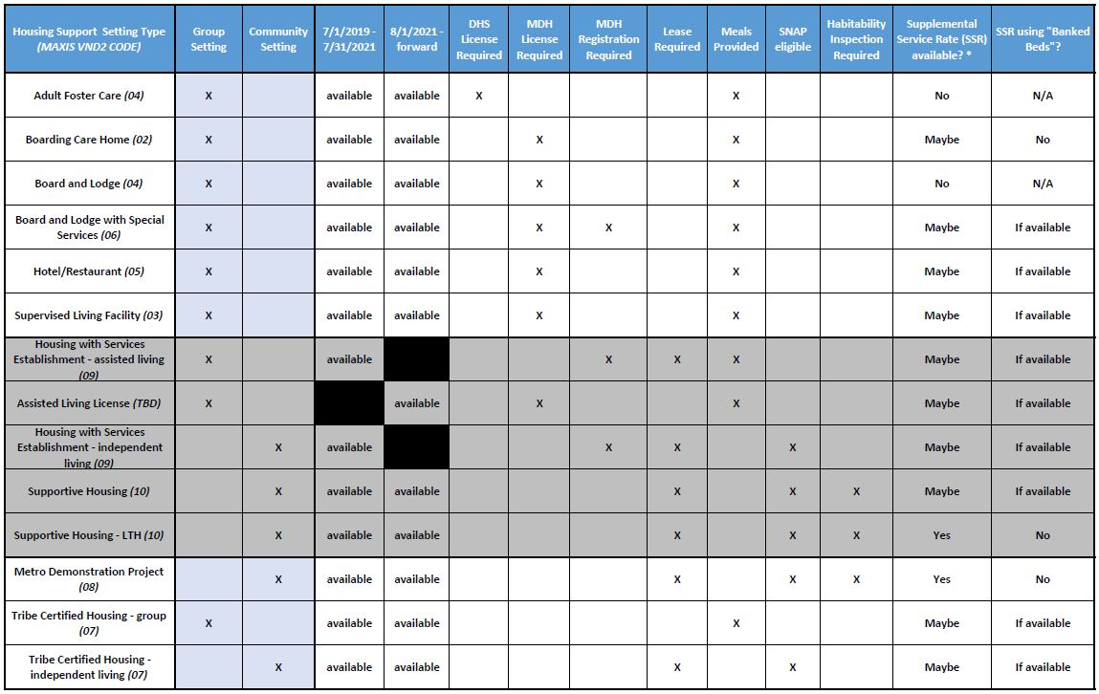
Housing Support Places

Slide 24
Supportive Housing
Habitability inspection for each unit
People in Long Term Homeless programs need:
LTH verification form
Documentation of referral from either
Coordinated entry system, OR
DHS approved direct access program

Slide 25
Talking with people about Housing Support
“How can I find a Housing Support provider”?
Tools
HB101 Places
Hennepin Housing Key
Housing Link
Disability Hub
Coordinated Entry – may be required for some pathways
DHS direct access pathways (usually targeted)
Counties and tribes may have local expert
Existing provider networks
Notes:
Depends on person’s needs and preferences

Slide 26
Talking with people about Housing Support
“Housing Support doesn’t work for families”.
Families with an eligible adult can receive Housing Support!

Slide 27
Housing Support for families receiving MFIP
Housing Support recipients who also receive MFIP pay $146 toward their housing expenses regardless of the size of their family.
Families can use their remaining income to pay for housing costs that aren’t covered by Housing Support.
Housing Support recipients who also receive MFIP pay $146 toward their housing expenses regardless of the size of their family.
Families can use their remaining income to pay for housing costs that aren’t covered by Housing Support.
 | Family of One | Family of Two | Family of Three
MFIP cash grant | 350 | 537 | 632
Housing Grant | 110 | 110 | 110
Person Pays | 146 | 146 | 146
Remaining Income | 314 | 501 | 596

Slide 28
Talking with people about Housing Support
“I don’t want to give up my SSI”.
Housing Support may not be the best
long-term fit.
People can start with Housing Support and transition to MSA Housing Assistance

Slide 29
Transition in context:
Stop Housing Support and
Start MSA Housing Assistance
Services
Housing
Supportive Housing
LTHSS
HUD Homeless programs
Personal Care Assistant (PCA)
Waiver Programs
Mental Health
Targeted Case Management
Assertive Community Treatment
ARMHS
Grant funded supports (PATH / HSASMI)
Self-pay
Income supplements
Public Housing Authority
Vouchers
Section 8 (Housing Choice Voucher)
Bridges and Bridges RTC
Housing Trust Fund rental assistance
Family Unification Program
Project-based
Section 8
HUD Homeless programs
Housing Trust Fund rental assistance
Housing Support
Housing Support Supplemental Services (LTH and non-LTH)
MSA Housing Assistance
Life Factors
Income / Assets
Housing stability
Disability status
Living situation
Preferences
Service need
Housing Stabilization Services (7/2020)
Notes:
Three fundamental pieces of GRH that are in place in every GRH living situation

Slide 30
MSA – Housing Assistance
Federal
SNAP
$783 SSI
$81
MSA
$1256
Self directed to personal expenses
$392
Housing Assistance
(Special Needs Payment)
State

Slide 31
Minnesota Supplemental Aid (MSA)
State-funded monthly cash supplement for some SSI recipients and low-income RSDI recipients
31,000 recipients, $37M program cost
Must be over age 18 (unless blind), and:
(1) Receiving any amount of SSI, or
(2) Would receive SSI but for excess income (and over 65, blind, or disabled)

Slide 32
Supplemental Security Income (SSI)
SSI is a federal cash assistance program for people who:
Are elderly (over 65), blind, or disabled, and
Have limited income and resources
SSI is an entitlement program; RSDI (aka SSDI) is a disability insurance program
2020 SSI rates (Federal Benefit Rate or FBR):
$783/month-individual ($794 on 1/1/2021)
$1,175/month-couple ($1,191 on 1/1/2021)
Some people get both SSI and RSDI benefits

Slide 33
Applying For Assistance
People don’t get MSA automatically when approved for SSI. They must apply for MSA:
Online: https://applymn.dhs.mn.gov/ or
Using the Combined Application Form (DHS-5223). Check the “cash” box on page 1 and sign/date.

Slide 35
Combined application - Question 24

Slide 36
MSA benefits
$783 SSI
+ $81 MSA
$864 total
Additional MSA “special needs” benefits can include:
Representative payee fees ($25/month)
Guardian/Conservator fees (up to $100/month)
Special diets (if prescribed by doctor; amount varies)

Slide 37
MSA Housing Assistance
Must be eligible for MSA and
Be under age 65 when applying and
Have monthly housing costs of more than 40% of gross monthly income
Housing Costs = Rent and Utilities
Gross monthly income does NOT include MSA benefits

Slide 38
MSA Housing Assistance
and one of the following…
Relocating from an institution (hospital, nursing facility, RTC, ICF-DD or IRTS program); or
Eligible for Personal Care Assistance (PCA) services; or
Receiving waivered services; or
Transitioning from Housing Support

Slide 39
MSA Housing Assistance
$783 SSI
+ $81 MSA
+ $392 MSA Housing Assistance*
$ 1,256 Total Income
This is a 60% increase in income over SSI alone!
Caveat: Any increase in MSA benefits may decrease SNAP benefits. The impact depends on many factors.

Slide 40
Scenario: Transition from Housing Support to MSA Housing Assistance
I have a client on SSI who wants to transition from Housing Support to MSA Housing Assistance. What should I know?
Plan ahead so there is no gap in funding. County needs AT LEAST one full month to turn HS off and MSA HA on.
Is this client moving from a Housing Support facility (like a board and lodge) or are they “transitioning in place” (like in an LTH supportive housing program)? How much independent living experience does the client have?
Will you continue to provide services? Is this client on a waiver or eligible for Housing Stabilization Services? Coordinate this carefully.
Talk with the client’s financial worker. Provide all verifications showing the client is eligible, up front.
Can this client manage their finances appropriately, or will they need help? Stress the importance of budgeting.
Communicate with the landlord so there are no surprises about changes in the way rent is paid, or by whom.

Slide 41
Contact DHS
For Housing Support questions, contact: dhs.dhs.grh@state.mn.us
For MSA Housing Assistance questions, contact: john.petroskas@state.mn.us

