Slide 1
Keep Heading Home Together: Lessons from 2020 and implications for the future
November 19, 2020
Notes:
Cathy
Welcome and introductions

Slide 2
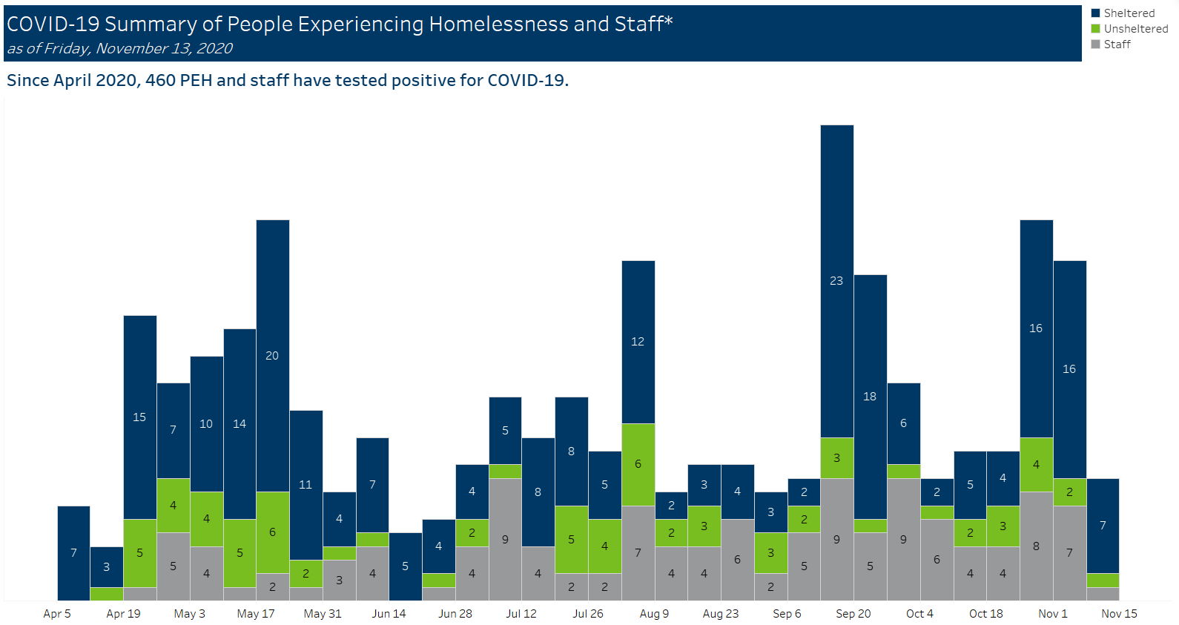
Summary of COVID Response
Rapid deployment of the largest increase in homeless specific funding in state history
$75 million in new State and Federal funds to support people experiencing homelessness
Most funds issued within two-week rolling request cycle
$106 million in federal funds allocated to prevent evictions and homelessness
Coordinated with public health and emergency management response
Collaboration and creativity including new hotel-to-home model to support encampment evacuations
Weekly webinars with many stakeholders
Daily communication across interagency team
Infection rates generally low, well below initial worst case scenarios.
Many outbreaks intercepted and contained over the summer.
First large outbreak in September with 50% positivity rate
Notes:
Cathy

Slide 3
Key Takeaways
Key Learning | Potential Solutions
Homelessness is a public health crisis that is compounded by COVID-19. | Create public-health informed recommendations for how the response to homelessness is implemented. Recognize and address the ways in which public health systems have not met the needs of indigenous communities or communities of color or have actively perpetuated harm. Formalize and strengthen connections between homeless response and local public health systems, particularly where Health Care for the Homeless programs do not operate. Expand Health Care for the Homeless programs and other similar interventions including behavioral health services.
Creative and rapid solutions are possible. | Take what we have learned in these crises and build a plan and response system that is creative and adaptable. Sustain the sense of urgency and imperative for rapid action the problem deserves. Continue more intensive interagency work on solutions.
Notes:
Eric

Slide 4
Key Takeaways
Key Learning | Potential Solutions
We must center equity and implement anti-racist policies and practices. | Frame and implement the response to homelessness as part of the response to racist policies and practices. Adopt and expand practices that shift funding, decision-making, and other forms of power to indigenous communities and communities of color. Be racially explicit and disaggregated in reporting the impact of funding decisions, program expectations, and program outcomes.
Stable and sustained funding to support shelter and outreach capacity and infrastructure is needed. | Document the impact of these investments to motivate sustained investments. Model the true cost of responding to homelessness. Propose specific policies and budget options to create consistent and robust funding to sustain the homeless response on an ongoing basis.
An accountability structure is needed for the homeless response system. | Develop policy changes that clarify roles among levels of government for responding to homelessness, to increase accountability and partnership.
Notes:
Eric

Slide 5
Heading Home Together Plan
The Minnesota Interagency Council on Homelessness is developing the next iteration of our Heading Home Together Plan.
Our commitment is to:
Emphasize the need for resources, investment, and commitment from the public sector as critical to solving homelessness.
Bring an equity focus to our efforts and remain explicit about the ways that homelessness is a product of racism, which in turn fuels public health crises.
Center the expertise and insight of people with lived experience of homelessness, who know where and how our collective response to homelessness has failed and who are best poised to name what is needed to improve those responses.
Develop a plan and process to intentionally consult people with lived experience, providers, local communities, philanthropy, and the public.
Notes:
Cathy

Slide 6
Plans for Ongoing Community Engagement
Developing an ongoing to structure to engage with stakeholders.
Meet communities where they are already convening to share information and get regular input on the state’s work.
Collect and post summaries to share across groups on a new website.
Notes:
Elizabeth

Slide 8
Share Your Ideas
How would you like to regularly engage with the Council?
What should we be thinking about as we develop our engagement plan?
Who should we be regularly meeting with?
Notes:
Elizabeth

Slide 9
Visit the Heading Home Alliance COVID-19 page
Latest resources, guidance, and contact lists
https://headinghomealliance.com/covid-19-response/
Notes:
Elizabeth

Slide 10
Weekly Newsletter
For announcements and regular information, sign up for Minnesota Housing’s eNews - http://www.mnhousing.gov/sites/np/enews
Select “Topics and Issues for Providers Serving People Experiencing Homelessness”
Please encourage your colleagues to do so!
Notes:
Elizabeth

Slide 11
Thank you!
Notes:
Cathy

