Slide 1
Minnesota Housing Grant Programs
Diane Elias, Nancy Urbanski, Ellie Miller & Erin Menne
November 17, 2020

Slide 2
Our Mission
Housing is the foundation for success, so we collaborate with individuals, communities and partners to create, preserve and finance affordable housing.
Notes:
Minnesota Housing’s mission is to provide access to safe, decent, affordable housing and build stronger communities across the state by offering products and services to help Minnesotans buy and fix up their homes and stabilize neighborhoods, communities and families.
Minnesota Housing also supports the development and preservation of affordable rental housing through both the financing and long-term asset manage­ment of projects and developments.
The agency has also pioneered a successful model for supportive housing that helps stabilize the lives of some of the state’s most vulnerable citizens.

Slide 3
Grant Programs Overview
Family Homelessness Prevention and Assistance Program
Rental Assistance
Bridges
Housing Trust Fund
Homework Starts with Home
Discussion of future funding

Slide 4
Polls
Who are you? Do you have experience working directly with these programs?
Notes:
Current grantee
Not a grantee/interested in applying
Not a grantee/want to know as referral resource
Other

Slide 5
Family Homelessness Prevention and Assistance Program (FHPAP) Overview

Slide 6
FHPAP Overview
Established in 1993 by the Minnesota Legislature
https://www.revisor.mn.gov/statutes/cite/462a.204
Currently provides more than $20+m in funding to 20 grantees statewide, including counties, tribal nations and community based nonprofit organizations
Advisory Committee – community response

Slide 7
FHPAP Outcomes
Reduce the number of people who become homeless for the first time (prevent)
Reduce the number of people who experience homelessness (rare)
Reduce the length of time people experience homelessness (brief)
Reduce the number of people who return to homelessness (one-time)
Increase equitable outcomes for households that are disparately impacted by homelessness (equity)

Slide 8
FHPAP Eligible Recipients
Household income must be at or below 200% of federal poverty guidelines
Minnesota resident or a household otherwise approved by Minnesota Housing
Be homeless or at imminent risk of homelessness and in need of services and/or financial assistance due to a housing crisis
Notes:
Serves families, singles, youth/unaccompanied youth (under age 25)

Slide 9
FHPAP Eligible Expenses
Administration
Support Services
Direct Assistance
Rental deposit
Rent payment
Utilities (including past due)
Transportation or other costs
Notes:
Funds cannot be used for more than 24 months of assistance

Slide 10
Website
http://www.mnhousing.gov/sites/multifamily/fhpap
including contact list for client referral
Notes:
Including contact list for client referral

Slide 11
Questions?

Slide 12
Rental Assistance Programs Overview
Bridges & Housing Trust Fund

Slide 13
Bridges Overview
Minnesota Housing currently provides funding statewide, to housing agencies, tribal nations and community based nonprofit organizations
Funds are awarded through a competitive Request for Proposals (RFP) process
Notes:
Minnesota Housing currently provides funding statewide, to Housing Agencies, tribal nations and community based nonprofit organizations
Funds are awarded through this Competitive RFP process
Bridges and Bridges RTC will be a combined RFP this biennium, and the grant cycle for both programs is a two year grant cycle beginning July 1, 2019 and ending June 30, 2021.

Slide 14
Bridges Overview (continued)
Over $11,000,000 in grants from two sources
The available funding may be adjusted and is contingent on the amount awarded from the Minnesota Legislature and the Minnesota Department of Human Services (DHS)
The Bridges grants do not include funds to provide supportive housing services.
Notes:
Up to $10,277,000 is available for rental assistance for both programs.
Bridges grants do not provide funding for services. Service funding is available through DHS.
The RFP instructions state that the available funding amount may change based on legislative appropriations.
Looking at a million dollar increase in the proposed budget

Slide 15
Bridges Eligible Recipients
The head of household or other household member must be 18 years of age or over and have a diagnosed mental illness as defined in Minn. Stat. 245.462, subd. 20 (a)
The household is eligible to receive a housing choice voucher (HCV) or can become eligible based on successful participation in the Bridges Program
The gross income of the household at the time of initial eligibility is at or below 50 percent of the area median income for the household size
Notes:
*read slide mental illness (MI) in the RFP documents regarding eligibility.
The participant must be eligible to receive a housing choice voucher (HCV) by the time they exit the Bridges Program. If they have barriers that can be reduced while in the program, they are eligible.

Slide 16
Bridges Priority Populations
People residing in an institution or other segregated settings who will be homeless upon discharge
People experiencing homelessness who are in need of permanent supportive housing as determined by an approved assessment tool and referred by Coordinated Entry (CE)
People who are experiencing homelessness or are at imminent risk of homelessness
Notes:
Bridges administrators must give priority to the following populations: * Highest priority given to people residing in an institution or other potentially segregated settings who will be homeless upon discharge.
A well established relationship should be in place with Coordinated Entry and a process of receiving applicants experiencing homelessness should also be in place.

Slide 17
Regional Treatment Center (RTC) Referral Sources
Is hospitalized at the Anoka Metro Regional Treatment Center(AMRTC); St. Peter Regional Treatment Center or Forensic Services and does not meet hospital level of care; and
Has significant or complex barriers to accessing and retaining housing; and
Is homeless or at imminent risk of homelessness upon AMRTC , St. Peter Regional Treatment Center or Forensic Services admission or discharge
Notes:
Under the Bridges RTC program, an eligible participant is defined as a person with mental illness who is eligible for Bridges and who is referred from the institutions listed above and who have significant and complex housing barriers. *

Slide 18
Eligible Uses
Bridges and Bridges RTC funds can be used for:
Direct payment to the landlord for the subsidy portion of the rent
Direct payment to the landlord for the security deposit
Direct payment to the landlord for the application fee (only eligible for Assisted Unit)
Direct payment to the landlord for the contract rent for up to 90 days during a medical and/or psychiatric crisis
Administration fee
Notes:
Rental assistance, security deposits, app fees
The administrative fee will be paid each month in which a participant resides in an eligible assisted unit.

Slide 19
Program Expectations
Bridges operates as a partnership between the organization that provides the rental subsidies and the LMH Entity that provides connections to housing supports and mental health services to participants
Responsibilities vary for different implementations and must be described in the Cooperative Agreement
A full list of activities for Bridges and Bridges RTC is listed in the Bridges and Bridges RTC Program Guide.
Notes:
Bridges grantees are required to participate in LMH Entity meetings and must have a collaborative working relationship with the LMH Entity in order to best serve people with mental illness who are experiencing housing instability.
Each activity is carried out by the Bridges grantee, the LMH Entity or both.

Slide 20
More info on Bridges
http://www.mnhousing.gov/sites/multifamily/bridges

Slide 21
Housing Trust Fund (HTF) Overview
State funded rental assistance program since 2002
Priority: to serve those with the highest barriers to housing stability
HTF currently provides funding to 39 grantees statewide, including non-profit and tribal organizations and housing authorities, serving 70 counties and 7 tribal nations
Notes:
The Housing Trust Fund was established by the Minnesota Legislature in 1988, and expanded to provide operating subsidy and rental assistance in 2002. In 2005 the HTF rules were modified to add a funding priority for programs and developments serving households experiencing long-term homelessness.
HTF currently provides funding to 39 grantees statewide, including non-profit and tribal organizations and housing authorities, serving 70 counties and 7 tribal nations

Slide 22
Housing Trust Fund (HTF) Overview
Temporary housing subsidy for persons with histories of homelessness and barriers to accessing and maintaining housing.
Rental assistance is combined with supportive services to increase housing stability.
Households pay 30% of their income towards rent
Notes:
Temporary housing subsidy for persons with histories of homelessness and barriers to accessing and maintaining housing.
Temporary – max of 5 years – able to move on to afford on own or qualify for permanent subsidy. exceptions for persons on a waiting list for a permanent source of rental assistance, for those who cannot apply for other rental assistance due to closed waiting lists, or for those ineligible for federal rental assistance
Rental assistance is combined with supportive services to increase housing stability.
Households pay 30% of their income towards rent. Maximum subsidy is the difference between 30% of gross income and the local payment standard
Similar to Section 8 or Housing Choice Voucher but with a little more flexibility & more targeted.
One of the features of the Housing Trust Fund rental assistance is it’s flexibility to be used for programs focusing on different populations, including families and individuals, adults and youth. Re-entry – targeting persons who are corrections-involved. Also, as we will discuss next, targeted families/individual identified as homeless in school systems.

Slide 23
HTF Eligible Recipients
Household gross income at or below 60% of area median income (AMI) at initial occupancy
priority at or below 30% AMI
Referrals for HTF assistance must come through the local Coordinated Entry (CE) System, with a requirement to serve persons meeting High Priority Homeless eligibility criteria.

Slide 24
HTF Direct Assistance
Temporary rental assistance
Security deposits
Rental application fees
Utility connection fees

Slide 25
More info on HTF
http://www.mnhousing.gov/sites/multifamily/htf including list of HTF administrators
Contact local Continuum of Care for referral
http://www.mnhousing.gov/sites/np/renters
Questions: MHFA.RENTAL-ASSISTANCE@state.mn.us

Slide 26
Questions?

Slide 27
Homework Starts with Home
27

Slide 28
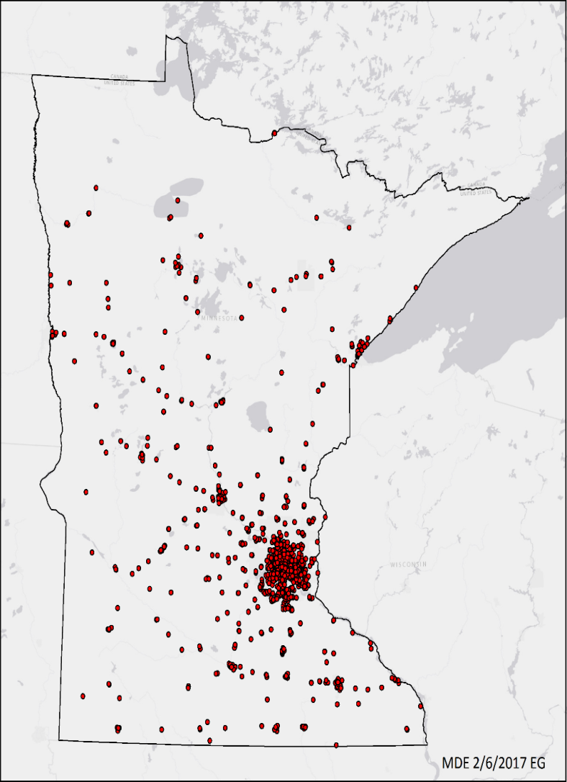
Purpose of this funding opportunity
8,079 students experiencing homelessness were enrolled in Minnesota schools on October 1, 2018.
Over 1,387 schools and 308 school districts
78 of Minnesota’s 87 counties
Student homelessness disproportionately impacts African American students , American Indian students, LGBTQ students, and students with disabilities.
11/4/2020
Notes:
Started as a rental assistance pilot program in 2014 that targeted homeless and highly mobile families with school aged children. First round of funding as an established program was in 2018 and we funded the 2nd round just this August

Slide 29
HSWH Overview
Interagency response to address the needs of students and families experiencing homelessness
Blend of funding
FHPAP
Housing Trust Fund
Philanthropic
Administered in local communities as a collaborative
Notes:
Beloved child
It takes a village
Concept – partnerships/collaborative
The Homework Starts with Home is a program created as an interagency response to address the needs of students and families experiencing homelessness by blending service funding (Family Homelessness Prevention and Assistance Program), rental assistance (Housing Trust Fund) and philanthropic funding. It is administered in as a collaborative between local participating governments, schools, and non-profits organizations.

Slide 30
Intended Outcomes
Reducing the number of students who become homeless for the first time (“prevent”)
Reducing the total number of students experiencing homelessness (“rare”)
Reducing the amount of time that students and their families remain homeless (“brief”)
Reducing the number of students who return to homelessness (“nonrecurring”)
Improving school attendance and academic achievement among students who have experienced or who are at risk of homelessness
PREVENT
RARE
BRIEF
Episodes of homelessness
New
incidents
Housing outcomes
NON-RECURRING
X
Recidivism
11/4/2020

Slide 31
Key Roles
Role | Eligible entities
Lead applicant | Nonprofit organization, unit of government, or quasi-governmental agency. Must be a current FHPAP or HTF administrator
Participating school(s) | School(s) that commit to satisfying public schools requirements of the McKinney-Vento Act
Participating Local Government Entity | County, tribal, municipal, regional governments, or public housing agencies responsible for “mainstream” housing, human services, or economic assistance program for people facing housing crises
HTF Administrator (Optional) | Current HTF Administrator in good standing with Minnesota Housing with demonstrated capacity to deliver rental assistance
FHPAP Grantee (Optional) | In seven-county Twin Cities metropolitan area, one or more county government. In Greater Minnesota, a county, a group of contiguous counties, a tribe, a group of tribes, or nonprofit organization with a sponsoring resolution from each county boards in service area
Landlord or Owner (optional) | Landlords or owners willing to partner with the program.

Slide 32
HSWH Recipients
Eligible Recipients
Persons or families whose incomes at the time of initial occupancy do not exceed program limits established by the HTF administrator and are approved by Minnesota Housing
A household’s income cannot exceed 60% of median income.
11/4/2020

Slide 33
HSWH Direct Assistance
Temporary rental assistance
Rapid rehousing rental assistance
Security deposits
Rental application fees
Utility connection fees
11/4/2020

Slide 34
Current Service Areas
St Paul – Amherst H Wilder Foundation/Ramsey Co
Beltrami Co - Bi-County Community Action Programs, Inc
West Central MN (10 county region) – Clay Co HRA/Mahube-Otwa Community Action Partnership, Inc
Minneapolis – Project for Pride in Living, Inc.
Hennepin Co - Minneapolis Public Housing Authority

Slide 35
More info on HSWH
http://www.mnhousing.gov/sites/multifamily/homeworkstartswithhome
HSWH Research Partner
Notes:
The Homework Starts with Home Research Partnership is a collaborative state-university-school-community project designed to integrate multisystem administrative data and analyze it in order to produce and disseminate high quality evidence pertinent to addressing the State and national challenge of student homelessness.

Slide 36
Questions?

Slide 37
Future Funding Focus
Better for our clients
Better for our administrators
COVID lessons learned
Equity
Notes:
Lessons learned – Government can go faster and differently than previously!
Combining programs?
How can we design the RFP to be better for our clients and administrators?
How can we design the RFP to be more responsive to pandemic?
How can we design the RFP to address equity concerns?

Slide 38
Poll
Prefer online application?

Slide 39
Poll
Would it work to have these resources pooled into one RFP instead of program-specific?

Slide 40
Poll
Would a grant writing workshop specific to these resources be helpful?

Slide 41
Thank You!

