Slide 1
Turning Data into Insight about Homelessness with HMIS
Selina Sun, Project Specialist, Institute for Community Alliances
Emily Salvaterra, Data Analyst, Institute for Community Alliances

Slide 2
Agenda
What is HMIS?
How can HMIS be used as an advocacy tool? What kinds of stories can HMIS tell?
How can advocates access HMIS data?
Q+A

Slide 3
POLL
What is your role?
I am a community advocate
I work directly with person experiencing homelessness
I don’t work directly with the homeless community, but I work with people who do
Other

Slide 4
POLL
How familiar are you with HMIS?
I work with it every day
I work with people who work with it
Don’t work with it or with people who do
I don’t use it but I use a comparable database
Don’t use HMIS or a comparable database

Slide 5
What is HMIS?
System used to collect data on provision of housing and services to persons experiencing or at risk of homelessness
Continua of Care are responsible for HMIS decision-making and oversight
200+ participating agencies

Slide 6
What is HMIS?
Identifiable client data
Track a person’s experience in the system
Transaction data
Monitor the availability and utilization of housing and services
Provider data
Evaluate effectiveness

Slide 7
How can HMIS be used for advocacy?
Publicly available dashboards show data on persons experiencing homelessness in Minnesota
Monthly System Performance Dashboard
Coordinated Entry Dashboard

Slide 8
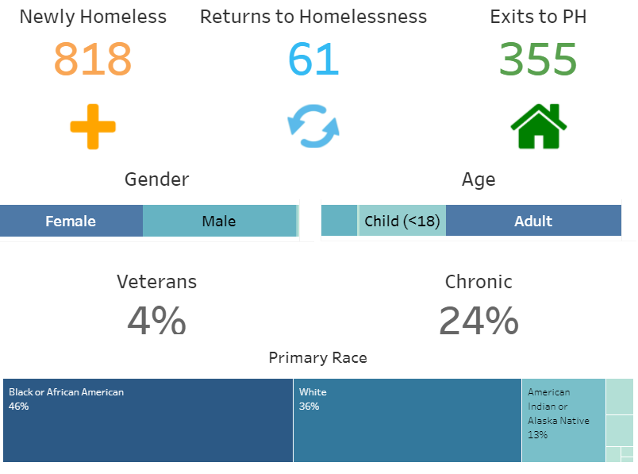
What kinds of stories can HMIS tell?

Slide 9
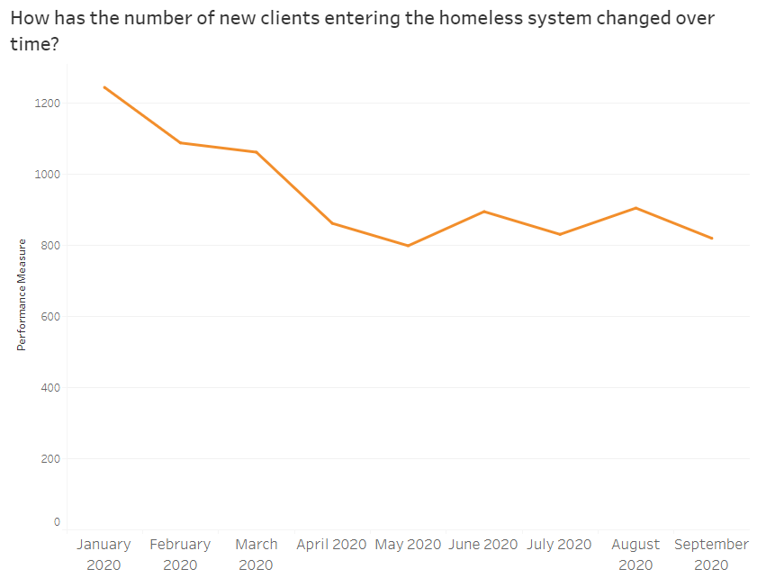
What kinds of stories can HMIS tell?

Slide 10
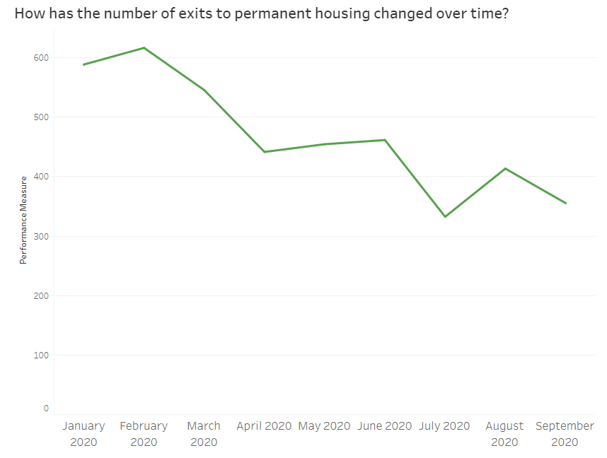
What kinds of stories can HMIS tell?

Slide 11
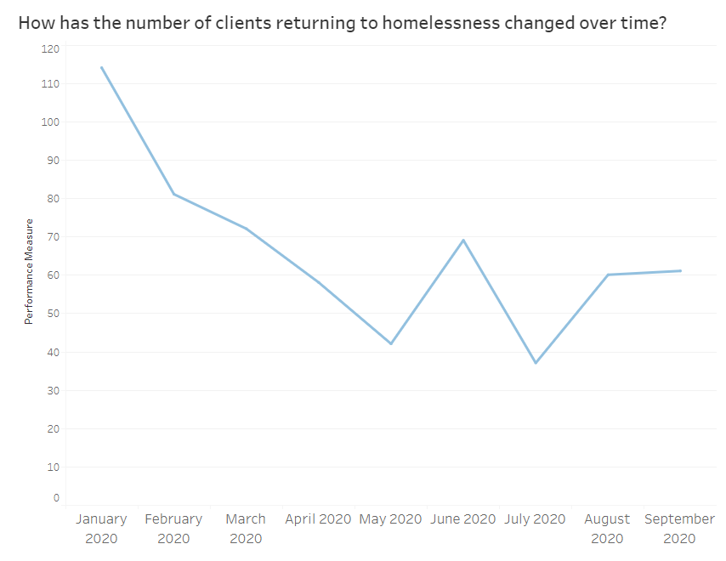
What kinds of stories can HMIS tell?

Slide 12
Homeless Clients Participating in Coordinated Entry
Homeless Clients
Recorded in HMIS
Everyone Experiencing Homelessness in MN

Slide 13
POLL
How familiar are you with Coordinated Entry?
I’ve never heard of it
I am somewhat familiar with it
I wrote the book on it

Slide 14
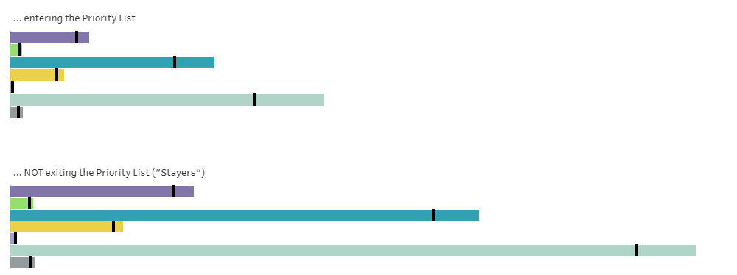
What kinds of stories can HMIS tell?

Slide 15
How can advocates access HMIS data?
Public dashboards: https://www.hmismn.org/minnesota-dashboards
Custom requests: https://www.hmismn.org/custom-report-request
Reports (for HMIS Users): https://www.hmismn.org/reportcollection

Slide 16
Q+A
Selina Sun
selina.sun@icalliances.org
Emily Salvaterra
emily.salvaterra@icalliances.org

