Slide 1
Minnesota Coalition for the Homeless Virtual Training Series November 16, 2020
Emergency Shelter in a Time of Pandemic
Non-Congregate Models: Lessons from Field

Slide 2
Workshop Format & Agenda
9:10 DHS Office of Economic Opportunity: Intro and Overview
9:20 Panel Presentation
Stepping Stone Emergency Housing: Julie Jeppson & Johnna Krantz
Community Action Center of Northfield: Amy Tudor
Cornerstone/Joint Shelter-Hotel Project: Denise Eng
Red Lake Homeless Shelter: Jordan May
10:00 Audience Questions for Panelists (Q&A Box)
10:15 Panel Discussion: Strengthening Post-Pandemic Shelter
10:28 Closing: MN Coalition for the Homeless

Slide 3
Emergency Shelter in a Time of Pandemic
DHS Office of Economic Opportunity
Normal Times: Awards grants for the following programs:
Homeless Youth Act (Street Outreach, Shelter, Transitional Living and Supportive Housing)
Transitional Housing Program (THP)
Safe Harbor Shelter and Housing / Shelter-Linked Mental Health
State Emergency Services Program (ESP) & HUD Emergency Solutions Grant (ESG)
Many other anti-poverty and food programs
COVID Times: Over $63M in Emergency COVID Response funding (since April 2020)
ESP COVID-19 Response Funds –Emergency State Appropriation (online survey)
Coronavirus Relief Funds (CRF) Shelter and Food –Emergency Federal Funding (online survey)
ESG-CV1 & CV2 (CARES Act) – Outreach, Shelter and Housing Assistance (two RFPs)

Slide 4
Emergency Shelter in a Time of Pandemic
Non-Congregate Sheltering
“Normal” Times. Typically:
$844K/year in State ESP to fund congregate & non-congregate shelter statewide
Frequent use of motel/hotel vouchers in areas of MN with no congregate shelter
Ave. 2-5 night stays, 1-2 households per hotel, minimal services (sometimes case mgmt.)
Emerging Trend: Apartment Units (agency-leased); longer stays/more stability
COVID Times: Massive shift to motel/hotel shelter options, in order to:
Decompress congregate shelters
Quarantine / isolate vulnerable populations or potential COVID-positives
Scale up for significant increases in unsheltered homelessness
Respond to other 2020 crises (e.g. encampments near Metro area civil unrest)

Slide 5
Panelists Perspectives on Non-Congregate Models
Stepping Stone Emergency Housing:
Johnna Krantz & Julie Jeppson
Community Action Center of Northfield:
Amy Tudor
Cornerstone/Joint Shelter-Hotel Project:
Denise Eng
Red Lake Homeless Shelter:
Jordan May

Slide 6
Johnna Krantz, LSW Program Director, Stepping Stone Emergency Housing
Julie Jeppson Executive Director, Stepping Stone Emergency Housing

Slide 7
Anoka County
Background & Timing
Shelter – max 36 residents
4 residents per bedroom
2 quarantine/isolation rooms
Hotel – currently 33 residents
Staff
2 Case Managers (2 FTE) who rotate between the hotel and the shelter
1 Hotel Advocate (.75-1 FTE)

Slide 8
Washington County
Contract with Washington County
Service provider for 2 hotels
Stillwater – 26 rooms (32 adults and 11 children)
Forest Lake – 22 rooms (26 adults and 2 children)
Staff
1 Case Manager (1 FTE)
1 Housing Navigator (1 FTE)

Slide 9
Differences between Anoka & Washington Models
Intakes/screening
Hotel allowing public to reserve rooms
Staffing
Population served
SSEH/County Partnerships

Slide 10
Funding
Funding structure for each model
Housing Support

Slide 11
Lessons Learned
Leadership
Partnerships/Relationships
Communication

Slide 12
Amy Tudor, LSW Client Services Manager, Community Action Center of Northfield

Slide 13
Emergency Shelter Units
4 emergency shelter spaces
Individual apartment units
Serving both families and individuals
2 month stay with periodic review for longer stay
Do not exit clients to homelessness
Trauma responsive intake process

Slide 14
Hotel Vouchers
Utilize local hotels on case-by-case basis
Risk of hotels saying no or not having room available
Intentional work with hotel staff
Flexibility

Slide 15
Pros & Cons
Increased funding = increased service capacity
Ability to provide longer stays
More contact and wrap around services
Same number of staffing = larger case load
Less in person contact during COVID = less trauma responsive
Longer stay = more intensive case management needed

Slide 16
Denise Eng Project Coordinator, Cornerstone Advocacy Services

Slide 17
Project Collective
9 metro area domestic violence shelters
Convened with the help of Violence Free Minnesota
Praxis International contracted to help coordinate
Funded through ESP $
Offsite housing to meet physical distancing requirements and provide protective housing for:
Medically vulnerable
Isolation for those with symptoms, suspected or confirmed COVID
Quarantine for those exposed to COVID

Slide 18
Considerations in setting up the program
The hotel must understand the population you’re working with
Who else might be housed in the hotel?
How will you handle meals?
Security concerns in a non-congregate setting

Slide 19
Special considerations for domestic violence
Distinction between domestic violence and homelessness
Heightened need for confidentiality
Need for comprehensive advocacy services
Relationships with law enforcement—for good or ill

Slide 20
Jordan May Executive Director, Red Lake Homeless Shelter

Slide 21
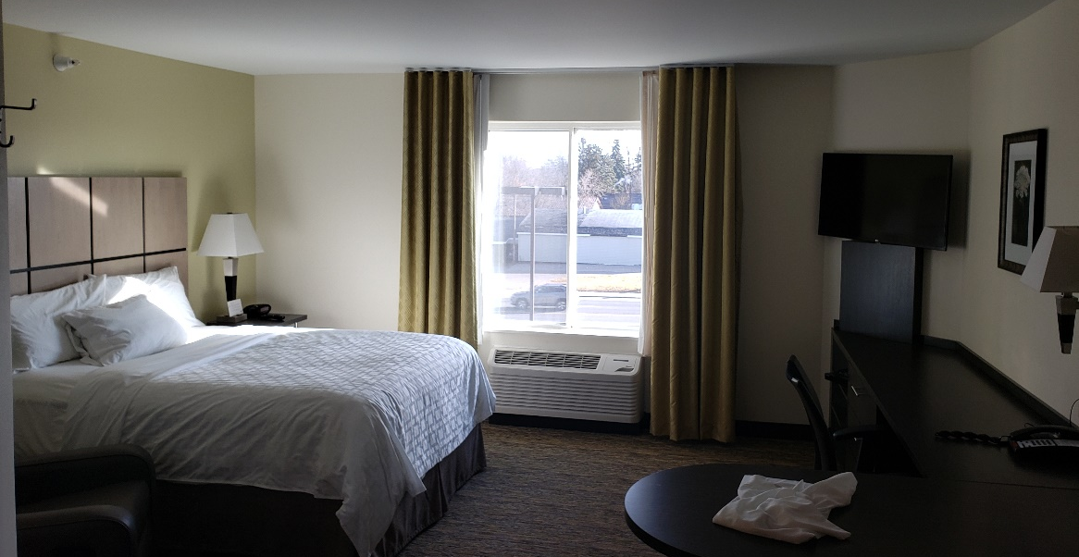
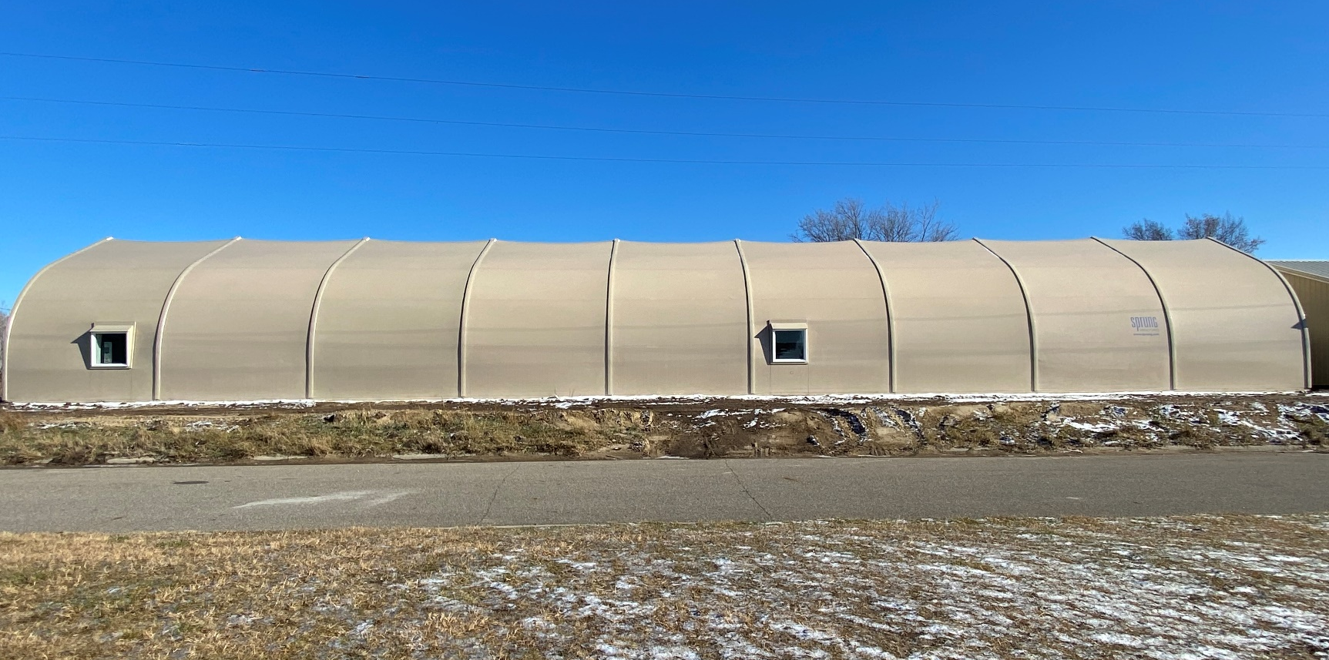
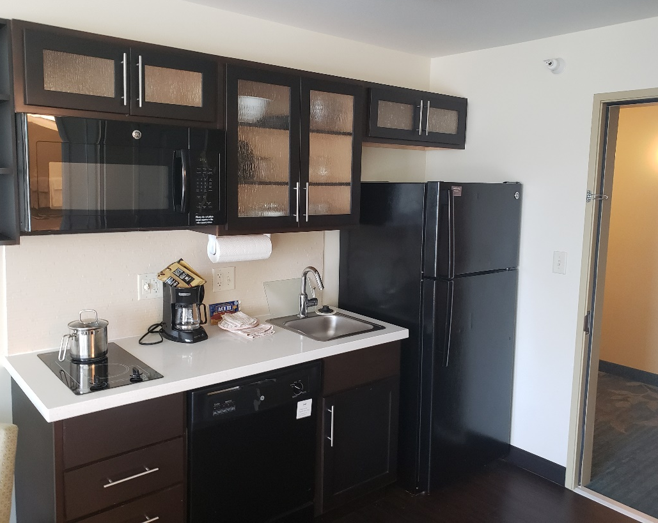
Sprung Shelter
Hotel to Home Project

Slide 22
Contact Information for Panelists
Stepping Stone Emergency Housing
Johnna Krantz
johnna.krantz@steppingstoneeh.org
Julie Jeppson
jjeppson@steppingstoneeh.org
Community Action Center of Northfield
Amy Tudor
tudor.amy@communityactioncenter.org
Cornerstone Advocacy Services
Denise Eng
denise@praxisinternational.org
Red Lake Emergency Shelter
Jordan May
jordanmay@redlakenation.org

Slide 23
Emergency Shelter in a Time of Pandemic
Strengthening Post-Pandemic Shelter
Q. What did we learn from sheltering during a pandemic that can be applied post-pandemic?
Q. How should emergency shelter responses (both congregate and non-congregate) change or be strengthened post-pandemic?
What do we gain/lose from longer shelter stays made possible w/ COVID funding?
Q. How can emergency shelters and policy makers sustain the increased awareness that the pandemic has brought to the role of emergency shelter in public health and safety.
Audience: If you have comments to share on these questions… submit in Q&A box.
We’ll try to incorporate some of them into discussion as time allows
Panel Discussion:

Slide 24
Thank you!
Questions for the Office of Economic Opportunity (DHS)?
Contact: Katelyn Warburton katelyn.warburton@state.mn.us or Isaac Wengerd isaac.wengerd@state.mn.us

